Slide 1

Authorization in Microservice / Distributed Systems
Halil İbrahim Kalkan

Slide 2

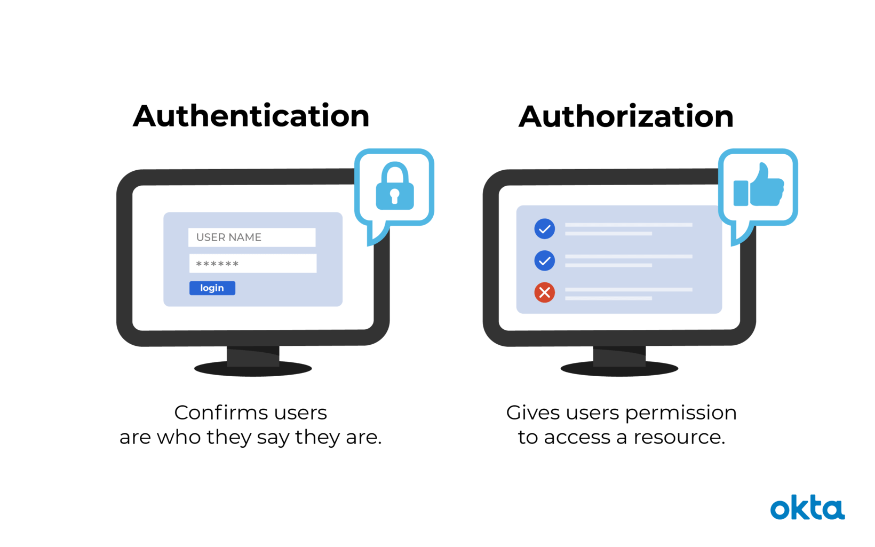
Authentication vs Authorization
Image source: https://www.okta.com/identity-101/authentication-vs-authorization/

Slide 3

Authentication The Authorization Code Flow
Web Application
Needs authentication
Access token
Authorization code
Token
request
Id Token
Access Token
API Gateway
browser
Access token
Authorization code
validation
Microservices
Redirects
Authentication Server (The Authority)
(Login & Consent UI)

Slide 4
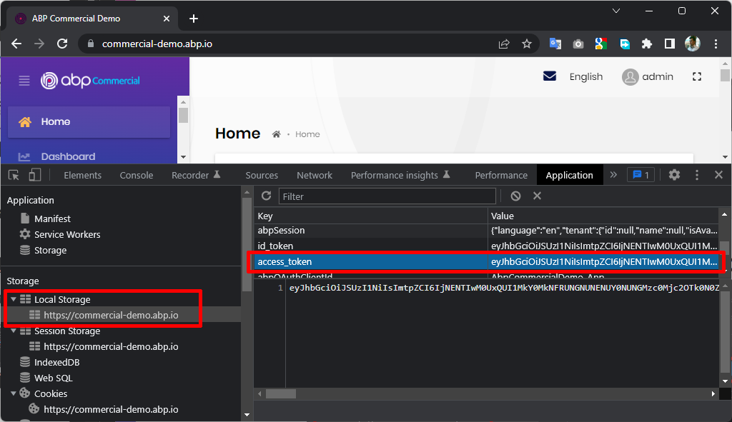
Storing the Access Token

Slide 5
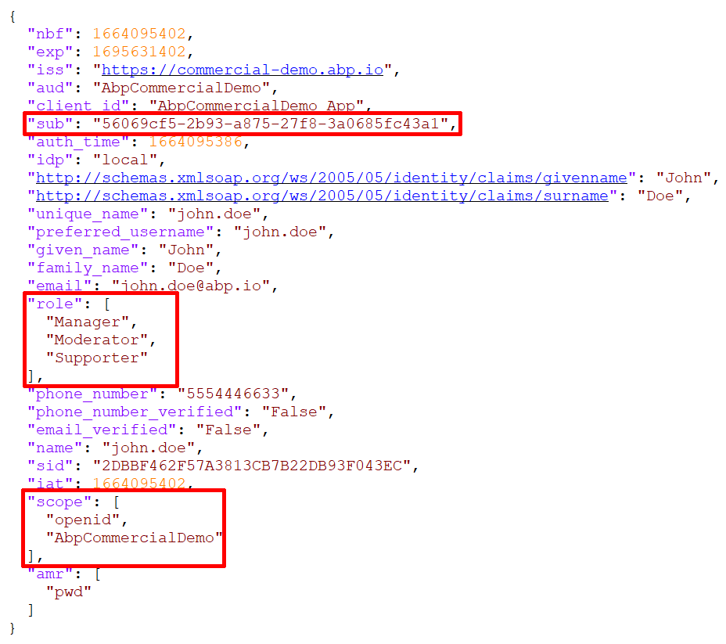
The Access Token
Standard claims
Sub: User Id
Role: Roles of the user
Scope: Allowed scopes
And your custom claims

Slide 6
Topic title
Content

Slide 7
Topic title
Content

Slide 8
Topic title
Content

Slide 9
Topic title
Content

Slide 10
Topic title
Content

Slide 11
Topic title
Content

Slide 12
Topic title
Content

Slide 13
Topic title
Content

